Slide 1
Development of a Non-pharmacological Model of Cognitive Impairment for the Evaluation of Putative Pro-cognitive Agents – Potential Relevance for Age-Related Cognitive Decline and Alzheimer’s

Slide 2
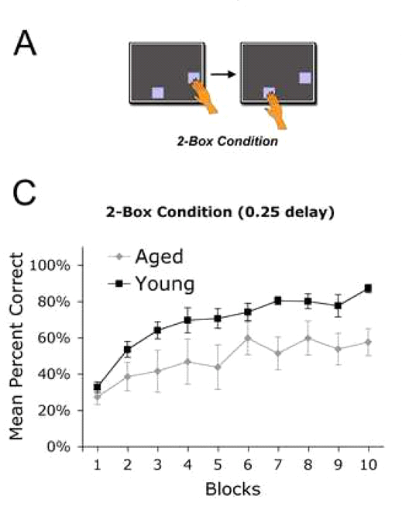
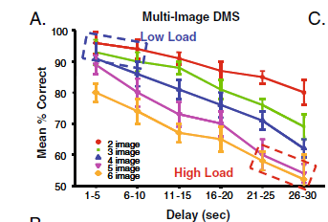
The Memory Load Model in Aging
Using a manipulation of the spatial delayed response task
incorporating a high memory load, we rendered performance
more sensitive to cognitive enhancement generally and better suited
to revealing such enhancement specifically in aged animals.
By increasing the number of wells to be selected from, and
increasing the length of the delays used, we have generated a
cognitive challenge in which the combined strength and spatial
resolution of neural representation can be tested. The effects of
such a challenge on performance of monkeys in delayed match to
sample has been previously revealed by Hampson et al. (2009;
bottom panel).
In human studies, the deficits evident with such an increase in load
appear to covary with the actual capacity of working memory.
This challenge is also sensitive to aging. In a 2-stage version
of the self-ordered spatial search task, Nagahara et al. (2010)
demonstrated a significant impairment in aged monkeys (top
panel). Given that D1 agonists have been shown
to improve working memory in aged monkeys (Castner and
Goldman-Rakic, 2004), we have now tested this model on a
group of adult and aged animals and used it to investigate
the selective effects of a D1 agonist on performance.
From: Nagahara et al. (2010) Neurobiology of Aging
From: Hampson et al. (2009) Psychopharmacology .

Slide 3
Methods
Rhesus monkeys (10 adults with an average age of 11.8 years and 9 aged animals (average = 22.1 years) were trained to stability on spatial delayed response with a mean ranging between 65 - 75 % correct with an SEM ≤ 2.5 % correct
Experiment 1: A total of four “challenges” were conducted with each animal wherein memory load was increased by an increment in both the number of spatial locations to be remembered (+ 2 wells) and an increment in the length of delays utilized in the task (N + 1 sec). Seven or more consecutive test sessions of stability wherein performance was within the animals baseline range were required between memory load challenges. Thus, memory load challenges occurred on average at two week intervals so as not to overtrain the animals on the more difficult task.
Experiment 2: Animals in each age group were assigned to one of two groups. One group received saline IM one hour prior to testing on challenge day 1, then 0.001 mg/kg SKF38393 IM one hour prior to testing on challenge day 2. The second group received 0.001 mg/kg SKF38393 on challenge day 1 and saline IM on challenge day 2. Challenge days had the same stability requirements as outlined above.
(Above) Measures the improvement/impairment of performance from a stable baseline of 65-75% correct with an SEM < 2.5%. Performance stability is achieved by increasing the number of spatially displaced wells and/or increasing the length of variable delays
From: Purves et al. 2001
Notes:
Updated-complete

Slide 4
Increasing Memory Load Markedly Impairs Spatial Working Memory In Both Adult and Aged Nonhuman Primates
90
Adult
Aged
80
70
Percent Correct
60
*
50
*
40
30
Baseline
Average
Challenge
Average
Baseline
Average
Challenge
Average
Spatial delayed response performance during the increased memory load tasks is significantly lower than baseline averages under normal testing conditions. ANOVA: Adults F[1,18] = 88.753; p < 0.001. Aged F[1, 16] = 134.869; p < 0.001. This data was also normalized (not shown) to account for variances in the number of wells between animals using the formula: (X-(1/Y*100))/(100-(1/Y*100)) where: X = DR score (as a % correct) Y = # of wellsThese results also showed significant decrease during the memory load challenge. ANOVA: Adults F[1,18] = 47.775; p < 0.001. Aged F[1, 16] = 31.878; p < 0.001.
Castner et al. (2011) SFN Abstracts, Manuscript in preparation for Biol Psychiatry
Notes:
Updated-complete

Slide 5
Aged Animals Show a Trend for Greater Impairment at Longer Delays than Adults Under Increased Memory Load Conditions
6
5
4
Mean Number of Errors
Baseline Average Adult
3
Challenge Average Adult
2
Baseline Average Aged
1
Challenge Average Aged
0
(0 – 1)N
(3 – 4)N
Delays (N seconds)
Under increased memory load, both adult and aged animals exhibited significantly more errors at both short and long delays. 3-way ANOVA revealed a main effect of Delay F[1,8] = 139.014; p < 0.001, a main effect of Difficulty F[1, 8] = 129.838; p < 0.001, but there was not a main effect of Age F[1,8] = 2.226; p = 0.174 across all four challenges. No significant interaction was found: Delay * Difficulty * Age F [1,8] = 0.860; p = 0.381.
Castner et al. (2011) SFN Abstracts, Manuscript in preparation for Biol Psychiatry
Notes:
Updated—stats?

Slide 6
Adults Show Improvement Across Memory Load Challenges But Are Still Markedly Impaired Relative to Baseline Performance
75
Figure 3b (right)
70
y = -0.203x + 69.17
65
R
2
= 0.6437
60
55
Figure 3a (below)
Performance (% correct)
50
adult baseline
45
adult challenge
ANOVA: challenge 4 F[1,18] = 30.922; p < 0.001
40
y = 2.4x + 42
35
R
2
= 0.9931
80
30
0
1
2
3
4
70
Challenge/Baseline #
60
*
*
*
*
50
Percent Correct
40
30
20
10
0
B1
C1
B2
C2
B3
C3
B4
C4
Testing Condition (B = Baseline, C = Challenge)
Castner et al. (2011) SFN Abstracts, Manuscript in preparation for Biol Psychiatry
Notes:
Updated-complete

Slide 7
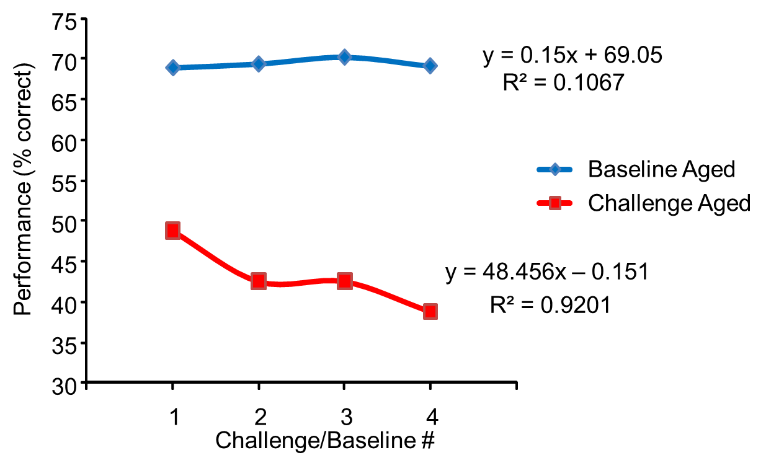
Aged Nonhuman Primates Do Not Show Improved Performance Across Repeated Memory Load Challenges
Figure 4b (right)
Figure 4a (below)
ANOVA: challenge 4 F[1,16] = 145.725; p < 0.001
80
70
60
*
*
*
50
*
Percent Correct
40
30
20
10
0
B1
C1
B2
C2
B3
C3
B4
C4
Testing Condition (B = Baseline, C = Challenge)
Castner et al. (2011) SFN Abstracts, Manuscript in preparation for Biol Psychiatry

Slide 8
Aged Animals Show Significantly Lower Scores on Challenge 4 than Adult Animals
60
A
7
B
50
6
*
5
40
4
Percent Correct
Mean number of errors
30
3
Adult baseline 4
20
Aged baseline 4
2
10
1
Adult challenge 4
Aged challenge 4
0
0
(0 – 1)N
(3 – 4)N
Adult
C4
Aged
C4
Delays (N seconds)
As can be seen in panel A, aged animals were impaired on the fourth memory load challenge as compared to adults ANOVA: Adult vs Aged F[1,17] = 9.240; p = 0.007. Under increased memory load in B, aged animals tended to exhibit more errors at both short and long delays as compared to adults on challenge 4. 3-way ANOVA revealed a main effect of Delay F[1,8] = 113.49; p < 0.001, a main effect of Difficulty F[1, 8] = 279.662; p < 0.001, but there was not a main effect of Age F[1,8] = 2.559; p = 0.148 on the fourth challenge. No significant interaction was found: Delay * Difficulty * Age F [1,8] = 0.351; p = 0.570.
Castner et al. (2011) SFN Abstracts, Manuscript in preparation for Biol Psychiatry

Slide 9
Pretreatment with SKF38393 Improves Cognitive Performance on High Memory Load in Aged but not in Adult Animals
Adult
Aged
Percent Correct
ANOVA: Adults F[2,25] = 41.123; p < 0.001. Performance under challenge conditions with or without SKF38393 is significantly impaired relative to baseline performance by Scheffe post hoc comparison (p < 0.001)
ANOVA: Aged F[2,24] = 48.260; p < 0.001. While both performance under challenge with or without SKF38393 was significantly (*) less than baseline; pretreatment with SKF38393 significantly improved performance under challenge conditions by Scheffe post hoc comparison (p < 0.001)#.
Castner et al. (2011) SFN Abstracts, Manuscript in preparation for Biol Psychiatry

Slide 10
Pretreatment with SKF38393 Improves Performance in Aged Animals at both Short and Long Delays Under High Memory Load Conditions
6
5
4
Mean Number of Errors
3
2
1
Baseline Average
Challenge Average
SKF38393
0
(0 – 1)N
(3 – 4)N
Delays (N Seconds)
Under increased memory load, aged animals exhibited significantly more errors at both short and long delays but this was ameliorated by pretreatment with SKF38393. 2-way ANOVA revealed a main effect of Delay F[1,8] = 66.175; p < 0.001, and a main effect of Treatment condition F[1, 8] = 34.018; p < 0.001, but there was no significant interaction between Delay * Condition F [1,8] = 0.509; p = 0.610.
Castner et al. (2011) SFN Abstracts, Manuscript in preparation for Biol Psychiatry

Slide 11
Castner et al. (2011) SFN Abstracts, Manuscript in preparation for Biol Psychiatry

